Slide 1
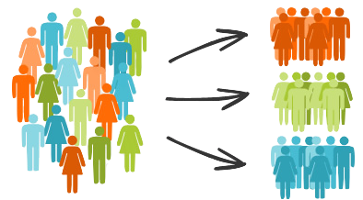
Customer Segmentation in the Hackathon
Data Science Capstone
Shrutika sankar

Slide 2
Customer Segmentation in the Hackathon
Data Science Capstone
Shrutika sankar

Slide 3
Can you recognize who is who in a customer group?

Slide 4
Context -Mandal Motors Enters a New Market
Automobile company Mandal Motors has plans to enter new markets with their existing products (P1, P2, P3, P4 and P5). After intensive market research, the head of sales Sylvester Sneekly deduced that the behavior of new market is similar to their existing market.
In Mandal Motors’ existing market, Sneekly’s sales team has classified all customers into 4 segments (A, B, C, D ). Then, they performed segmented outreach and communication for different segment of customers.
This strategy has work exceptionally well for them. They plan to use the same strategy on new markets on the new Customers

Slide 5


Problem
Predict the segment group for each of the 2427 new customers so as to increase car sales

Slide 6

Aims and Objective
Analyze what factors help identify customer segmentation
Create a model that classifies customers looking at current customer data
Identify what group each of the 2427 new customers belongs to.

Slide 7




Target
The new model’s prediction for the new market should have at least a 50% accuracy rate and 50% precision rate to match Mandal Motors current model for the older market.


Slide 8

Intro to Dataset
Customer Data
Analytics Vidhya’s dataset on Kaggle
8,068 Customers and 11 features including Customer Segment

Slide 9
What contributes to Customer Segment?

Slide 10
What factors into Customer Segmentation?
Customer Segment
Identity
Family
Spending Habits
Profession

Slide 11
What affects a vehicle’s Craigslist Price?
Identity
Family
Profession
Spending Habits
Gender
Age
Marriage Status
Family Size
Graduation Status
Work Experience (years)
Spending Score
Var_1

Slide 12
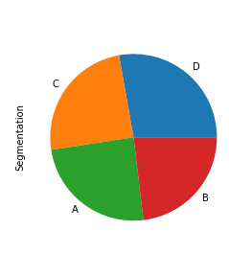
Segment
The amount of segments are around equally distributed though not exactly
The largest segment group is D
The smallest segment group is B
27.8 %
24.6 %
24.5 %
23.1 %

Slide 13

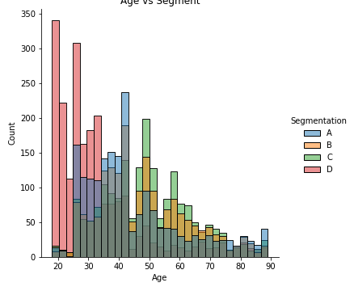
Segment vs Age
D segment Customers skew younger then A
Segment C and D are more symmetrically distributed

Slide 14

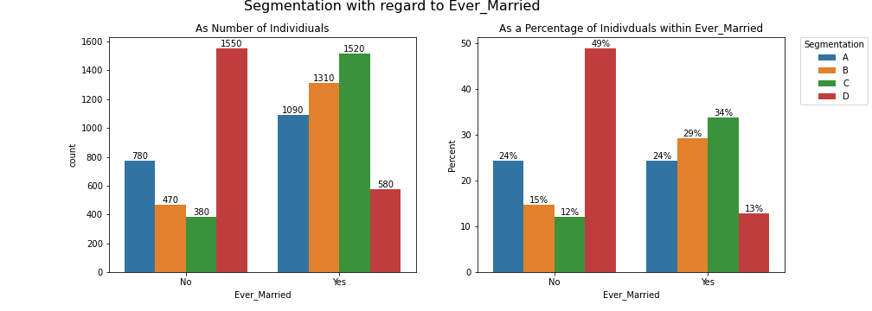
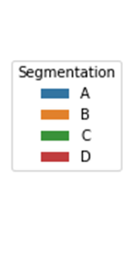
Marriage Status impact on Segment
Segment D is 3 times more likely to not be married then to be married
Segments B and C are 3 times more likely to be married then not married

Slide 15

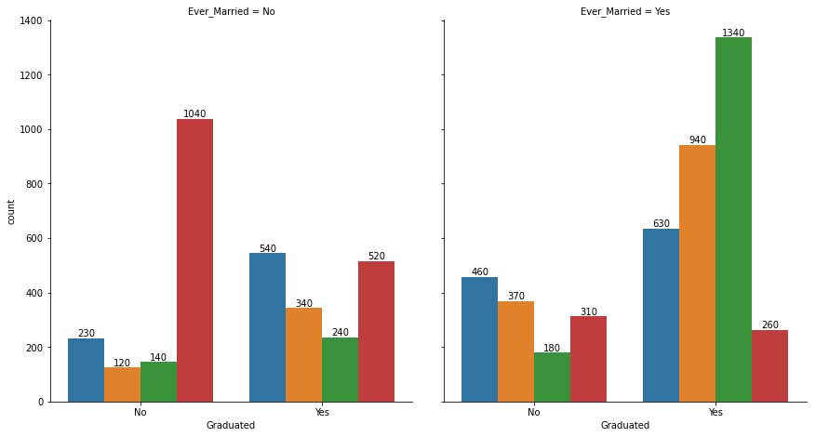
Segment vs Graduate and Married
If you are segment C you have a 70% likelihood of being both married and a graduate.
If you are married and you have graduated you are most likely to be in segment C followed B then A. If you are married and not graduated you are most likely segment A
If you are single and you haven't graduated you have a 2 of 3 chance of being segment D. However if you are single and you have single and graduated you have an around an 1 of 3 chance of being A or D

Slide 16
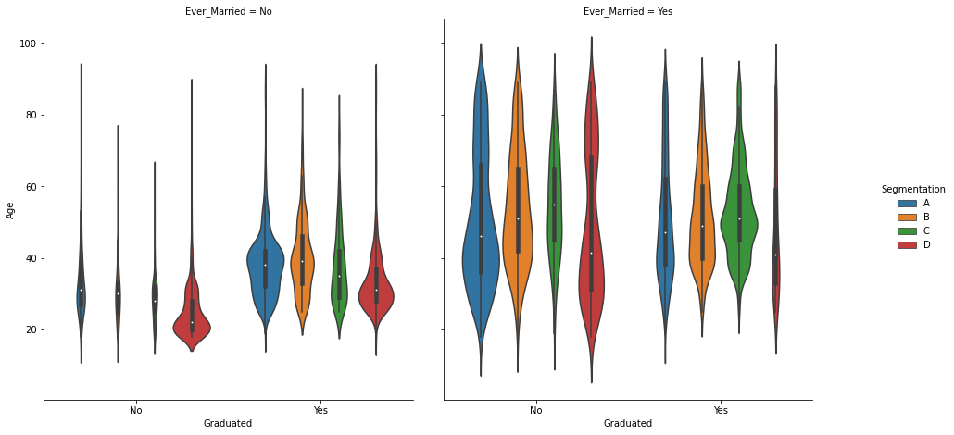
Segment vs Interacting Factors
D does skew young if you are not married.
If you graduated, single and under 30 yrs old you are more likely to be in Segment D.
If you graduated, single and over 30 you are more likely to be segment D

Slide 17
Creating the Model

Slide 18
Modeling Steps
Data Cleaning
Data Pre- Processing
Modeling 5 Algorithms
Algorithms comparison
Sampling Optimization
Sampling Comparison

Slide 19
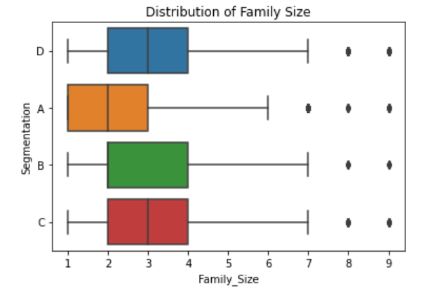
Data Cleaning Rules
Eliminate Customers where:
3 or more features are missing
2 or more features (not including Family Size or Age) are missing
Family Size is greater than 7 (95% of all customers had less)

Slide 20
Pre Processing
Feature Imputation
Spending Score to Ordinal.
Impute missing numeric features with the median
Labels turned to Dummies
Data Split
Data split into Train, Test
(55%, 25%, 20% respectively)
Data Scaled
Min Max Scaler
All categorical variables

Slide 21
Modeling (Choosing the Correct Algorithm)
Potential Algorithms
Random Forest
Extra Tree
Logistic
KNN
SVC

Slide 22
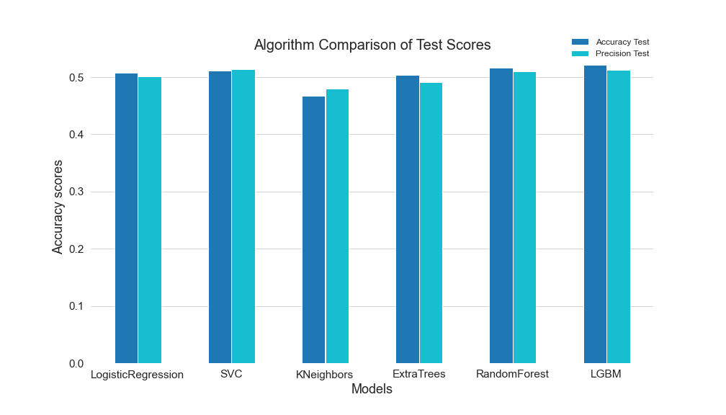
Accuracy Comparison

Slide 23
Model Comparison
SVC had the best precision results (0.514).
Light Gradient Boost had the best Average Accuracy results (0.522). It also has the second best Precision results 0.513
Algorithm | Accuracy Test | Precision Test
KNeighbors | 0.467 | 0.480
Logistic Regression | 0.507 | 0.501
ExtraTrees | 0.510 | 0.504
SVC | 0.511 | 0.514
Random Forest | 0.515 | 0.504
Light Gradient Boost | 0.522 | 0.513

Slide 24
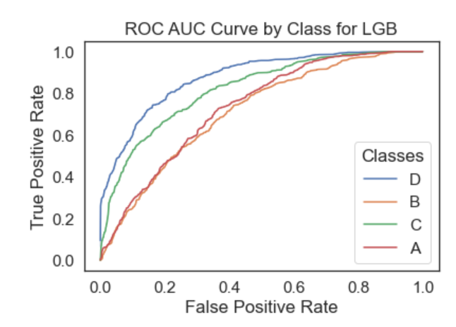
Model Limitations
This model was not as accurate for predicting Customers in Segment B or A.
These are also the segments with the least amount of data so that made sense. But we might be able to fix this with sampling

Slide 25
Sampling
None
Boosting
Gradient Boosting
Sampling

Slide 26
Algorithm Processing
Hyper tune parameters for each regression with the training data set
Utilized sklearn grid search
Evaluate between Algorithms with on testing set
Testing Data set (25% of the total data)
Evaluation Visualization: Confusion Matrix
Cross validate with 5 folds
Evaluation Metrics: Accuracy Precision
Create model using optimal parameters (including Sampling)
Only use training data set 75% of the total data)

Slide 27
Sampling Comparison
Boosting Sampling incrementally improved both Accuracy and Precision
Light Gradient Boost with | Average Accuracy Test | Average Precision Test
Base | 0.522 | 0.511
Hypertuned Parameters | 0.536 | 0.526
+ Gradient Sampling | 0.537 | 0.527
+ GBDT Sampling | 0.542 | 0.534

Slide 28
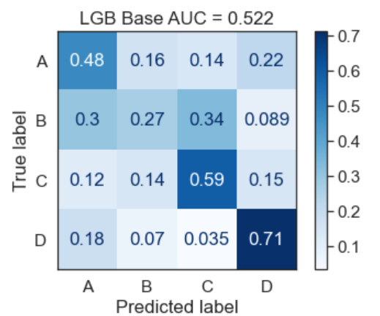
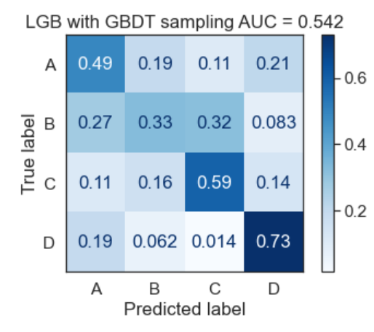
Confusion Matrix Comparison

Slide 29
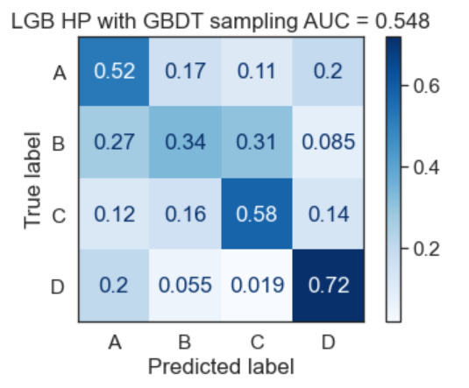
Confusion Matrix Comparison

Slide 30
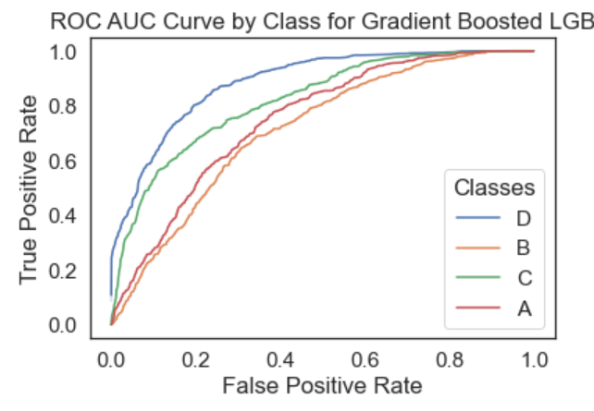
New Model Evaluation
Sampling Improvement
Improved overall average accuracy of the model from 0.52 to 0.55
Improved overall average precision of the model from 0.51 to 0.53
Sampling especially improved predicting the B class samples
The new model has on over:
54% average accuracy score
53% average weighted precision score
Since our success criteria was greater than 50%. This model passes evaluation.

Slide 31
Prediction Results

Slide 32

Prediction Results
Returning to our motivating question, of the 2657 customers we predicted:
753 of the Customers are in Segment A
451 of the Customers are in Segment B
611 of the Customers are in Segment C
812 of the Customers are in Segment D

Slide 33
Missing Data
Internal Spending Habits
More Segment B Customers
Internal reasons on why Groups B and C were Seperated

